Slide 1

INDIAN INSTITUTE OF TECHNOLOGY KANPUR -208016
Department of Civil Engineering
Hydraulics and Water Resources Engineering (HWRE)
CE 738A HYDROMETRY
PROJECT 1
"Evaluation and Application of Soil Moisture Sensors for Irrigation Management: Calibration, Sensitivity Analysis, and System Design"

Slide 2
INTRODUCTION Soil Moisture Monitoring for Irrigation
Importance: Helps in precision agriculture and effective water management.
Sensors: Measure volumetric soil moisture content.
Indicators:
Green: Above field capacity.
Blue: Between field capacity and wilting point.
Red: Below wilting point.

Slide 3
OBJECTIVE
Connect and calibrate two capacitive soil moisture sensors along with one resistive soil moisture sensor to determine which sensor reacts most effectively to variations in soil moisture.
Develop an irrigation scheduling system based on the most responsive of the two capacitive sensors.
Assemble a prototype of this system and solder the necessary components.

Slide 4
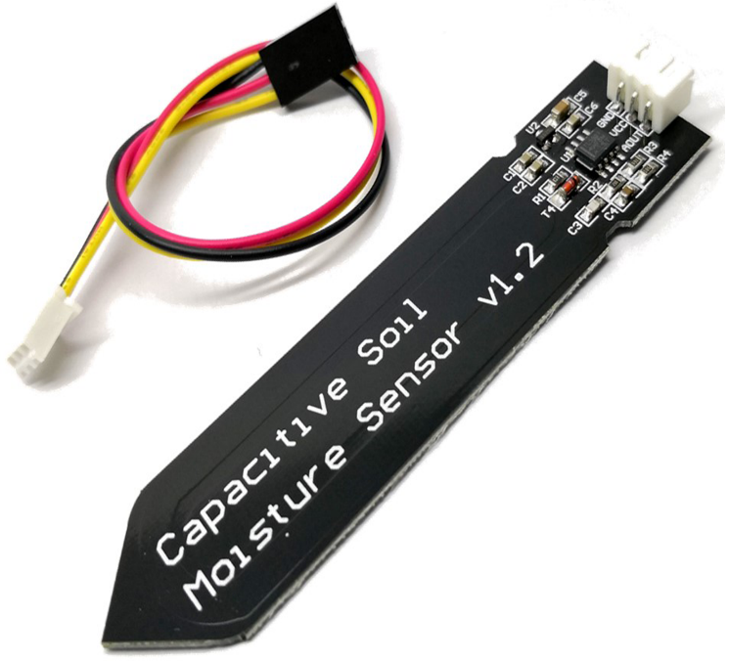
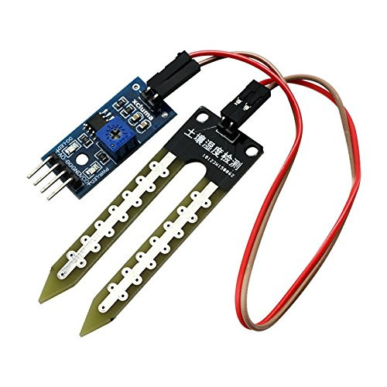
Materials Used
Capacitive Soil Moisture Sensors:
Measures capacitance changes due to soil moisture.
More durable and corrosion-resistant.
Resistive Soil Moisture Sensors:
Measures electrical resistance.
Less durable due to probe corrosion.
Fig.no 1.Capacitive sensor
Fig.no 2.Resistive sensor

Slide 5
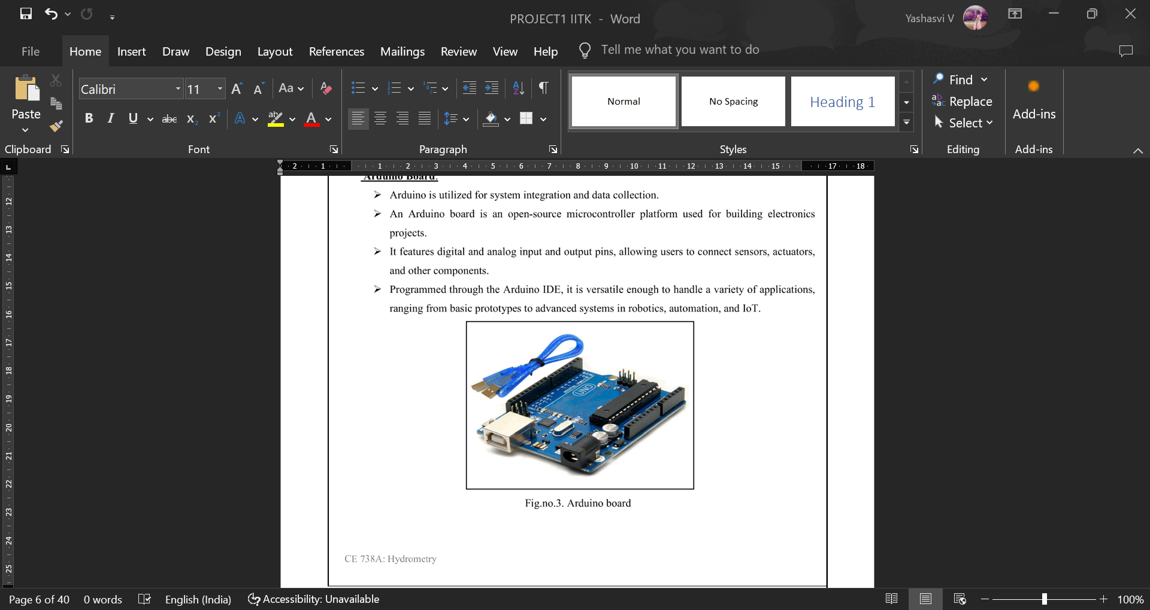
Arduino Board for data collection and system control.
LEDs & Jumper Wires for moisture indication.
Breadboard and Zero PCB board for circuit testing and assembly.
Fig.no 3.Capacitive sensor

Slide 6
Calibration Methodology
Soil Collection
Silty loam soil from an agricultural site.
Drying Method
Oven dried for 24 hours at 105°C
Bulk and dry Density
Average bulk density
Average dry density
Moisture Content Calculation
Irrigation system design
Calibration
Average moisture content: 23.72%.
Wet and dry calibration cycles.
Using the most capacitive sensor

Slide 7
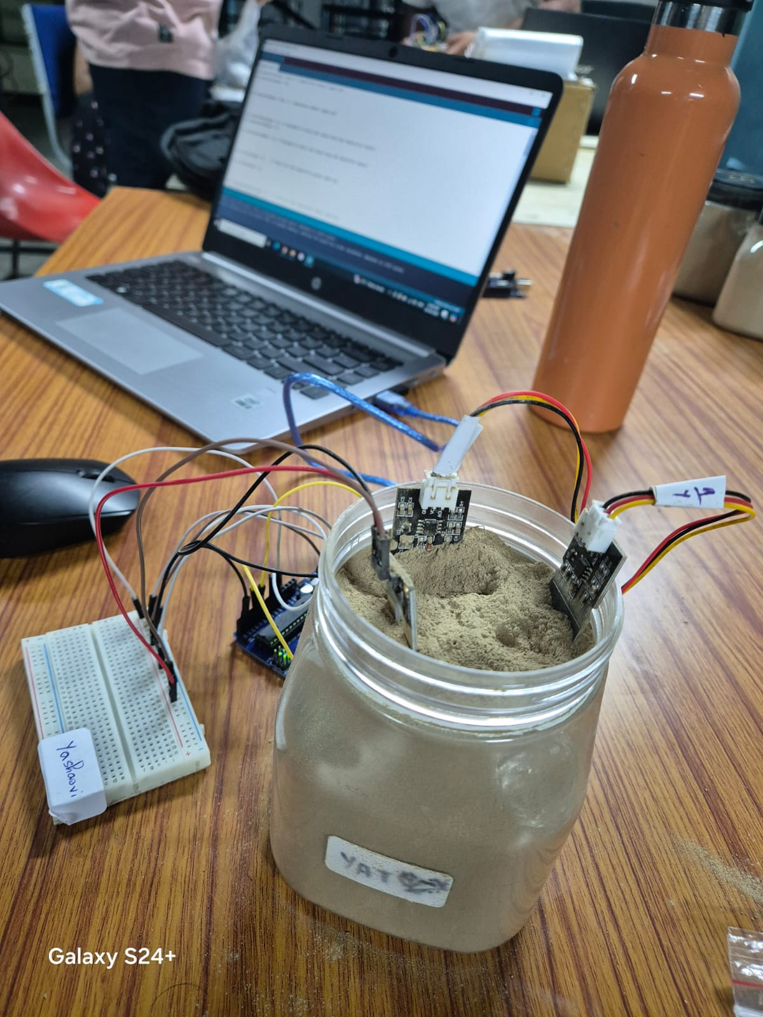
Sensor Interfacing & Calibration
Setup: Sensors connected to Arduino, code for sensor output readings.
Fig.no 4.Sensor connected with the Arduino board

Slide 8
Wet Calibration
Table.no 1.Sensor readings in air,water and dry soil

Slide 9
Table.no 2.Sensor readings wet cycle

Slide 10
Dry Calibration
Table.no 3.Sensor readings dry cycle

Slide 11
Sensor Calibration Data
Calibration Curves: Show sensor readings for different moisture levels.
Comparison: Capacitive sensors exhibit higher sensitivity and consistency than resistive sensors.
Hysteresis Analysis: Assessing sensor performance during dry to wet and wet to dry cycles.

Slide 12
Calibration curves
Chart.no 1.Hysteresis Capacitive sensor 1
Chart.no 2.Hysteresis Capacitive sensor 2

Slide 13
Chart.no 3.Hysteresis Resistive sensor

Slide 14
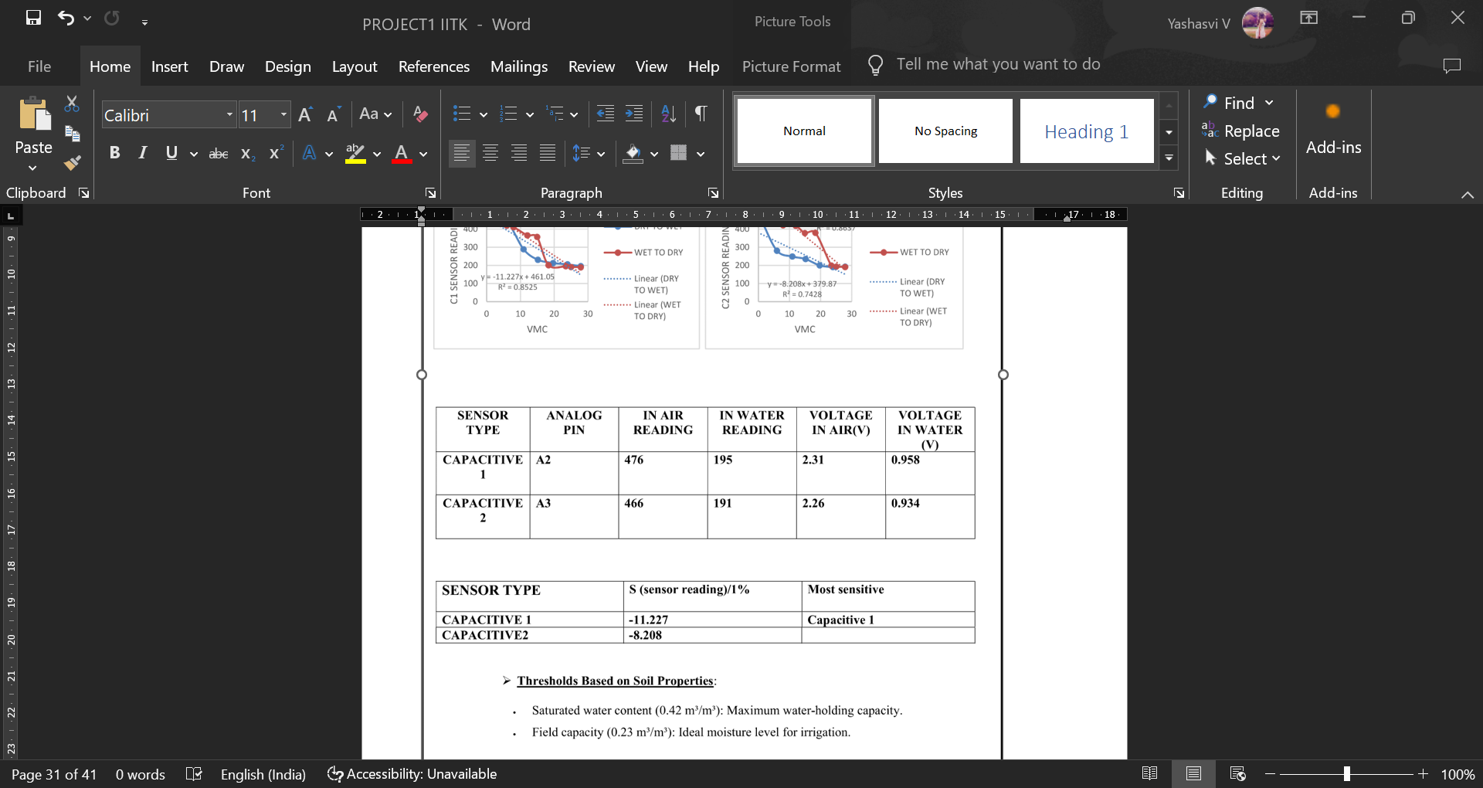
Sensor selection
The sensitivity of the capacitive sensor 1 is more compared to capacitive sensor 2
Therefore we use Capacitive sensor 1 for Irrigation system design

Slide 15
Irrigation System Design
Sensor Selection: Capacitive sensor 1 chosen for irrigation control.
LED Control:
Green: Above field capacity.
Blue: Between field capacity and wilting point.
Red: Below wilting point.
TinkerCAD Simulation: Virtual design and testing before soldering.

Slide 16
Prototype Design
Components: Arduino, LEDs, sensors, resistors, zero PCB board.
Circuit Design: Implemented in TinkerCAD, then soldered onto a zero PCB.
Testing: System tested with soil samples and verified for accuracy.

Slide 17
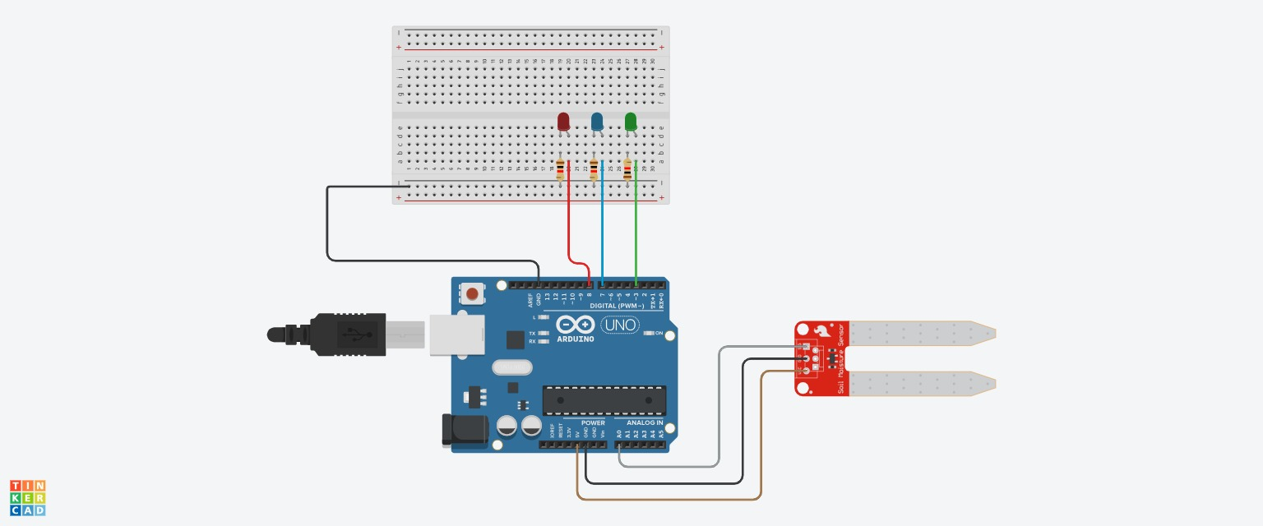
Fig.no 5.Prototype in Tinker CAD

Slide 18
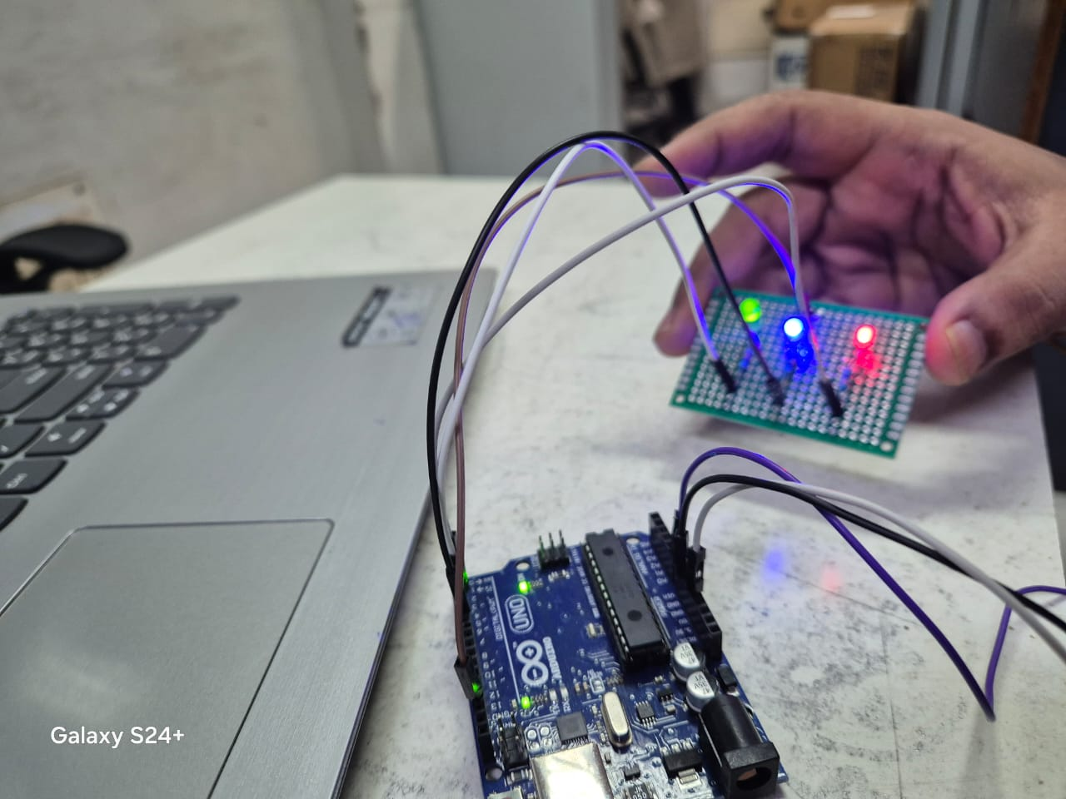
Fig.no 6.Circuit connection for scheduling irrigation system

Slide 19
Key Findings:
Capacitive sensors are more reliable than resistive sensors.
Real-time moisture monitoring through LED indicators.
Helps in water conservation and precision irrigation.

Slide 20
Conclusion
Summary: Successful calibration and implementation of an irrigation system based on soil moisture monitoring.
Future Use: Helps reduce water wastage and improves irrigation efficiency.
Achievements:
Calibration of soil moisture sensors.
Successful design and prototype of the irrigation scheduling system.

Slide 21
Future Scope
Full Smart Irrigation System
Automated Irrigation: Extend the project by integrating a water pump that is automatically activated when soil moisture drops below the wilting point, ensuring timely irrigation.
Weather Integration: Incorporate real-time weather data (e.g., rainfall forecasts, humidity, temperature) to optimize irrigation schedules and further reduce water usage.
IoT Integration: Enable remote monitoring and control by using IoT platforms (e.g., LoRaWAN, Wi-Fi) to transmit soil moisture data to a cloud server or smartphone app.

Slide 22
Improved Sensor Network: Multi-depth Sensing: Place sensors at multiple soil depths to capture a more detailed soil moisture profile, improving irrigation accuracy.
Calibration for Different Soil Types: Expand the system by calibrating it for various soil types (e.g., sandy, clayey) to increase its adaptability for diverse agricultural environments.
Energy Efficiency and Power Options: Solar-powered System: Develop a solar-powered version of the system for use in remote areas without a stable power source.
Low-power Components: Explore energy-efficient sensors and microcontrollers to minimize energy consumption, ensuring longer system uptime in off-grid locations.
Environmental Sustainability:Water Conservation Research: Study and quantify the water savings achieved by the system to assess its impact in regions with limited water resources.
Soil Health Monitoring: Expand the system’s functionality to monitor other soil parameters such as pH, salinity, and organic matter, providing a more comprehensive view of soil health.

Slide 23
Limitations
Resistive soil moisture sensors are prone to corrosion over time, which may affect their accuracy and longevity.
the capacitive sensors might experience hysteresis, leading to inconsistent readings as seen in your calibration data.
The system relies on a single soil moisture sensor at a specific depth, which may not capture soil moisture variability across different depths or field locations.
Factors such as temperature fluctuations and soil composition changes over time may affect sensor accuracy and require frequent recalibration to maintain reliability.
The system is powered through the Arduino, and no alternative power solutions (such as solar energy) have been integrated, which could limit its use in remote or off-grid agricultural sites.

Slide 24
REFERENCE
Class notes
Lab notes
Arduino- https://www.arduino.cc/
TinkerCAD- https://www.tinkercad.com/

Slide 25
Thank you

